Slide 1
FASB Update
Rahul Gupta
Practice Fellow
Financial Accounting Standards Board
August 20, 2015
The views expressed in this presentation are those of the presenter.
Official positions of the FASB are reached only after extensive due process & deliberations.

Slide 2
Today’s Agenda
Recent Standards
  Going Concern
  Pushdown Accounting
  Accounting for identifiable intangibles in a business combinations by a private company
  Simplifying presentation of debt issuance costs
  Simplifying measurement of inventory
  Deferral of effective date of revenue recognition
FASB/EITF/PCC Agenda
      Accounting for Financial Instruments

Slide 3
Recent Standards

Slide 4
Recent Accounting Standards Updates
No. | Title
2014-13 | Measuring the Financial Assets and the Financial Liabilities of a Consolidated Collateralized Financing Entity (a consensus of the EITF)
2014-14 | Classification of Certain Government-Guaranteed Mortgage Loans upon Foreclosure (a consensus of the EITF)
2014-15 | Disclosure of Uncertainties about an Entity’s Ability to Continue as a Going Concern
2014-16 | Determining Whether the Host Contract in a Hybrid Financial Instrument Issued in the Form of a Share Is More Akin to Debt or to Equity (a consensus of the EITF)
2014-17 | Pushdown Accounting (a consensus of the EITF)
2014-18 | Accounting for Identifiable Intangible Assets in a Business Combination (a consensus of the PCC)

Slide 5
Recent Accounting Standards Updates
No. | Title
2015-01 | Simplifying Income Statement Presentation by Eliminating the Concept of Extraordinary Items
2015-02 | Amendments to the Consolidation Analysis
2015-03 | Simplifying the Presentation of Debt Issuance Costs
2015-04 | Practical Expedient for the Measurement Date of an Employer’s Defined Benefit Obligation and Plan Assets
2015-05 | Customer’s Accounting for Fees Paid in a Cloud Computing Arrangement
2015-06 | Effects on Historical Earnings per Unit of Master Limited Partnership Dropdown Transactions (a consensus of the EITF)
2015-07 | Disclosures for Investments in Certain Entities That Calculate Net Asset Value per Share (or Its Equivalent) (a consensus of the EITF)
2015-08 | Pushdown Accounting—Amendments to SEC Paragraphs Pursuant to Staff Accounting Bulletin No. 115 (SEC Update)

Slide 6
Recent Accounting Standards Updates
No. | Title
2015-09 | Disclosures about Short-Duration Contracts (Insurance)
2015-10 | Technical Corrections and Improvements
2015-11 | Simplifying the Measurement of Inventory
2015-12 | Plan Accounting: Defined Benefit Pension Plans (Topic 960), Defined Contribution Pension Plans (Topic 962), Health and Welfare Benefit Plans (Topic 965): (Part I) Fully Benefit-Responsive Investment Contracts, (Part II) Plan Investment Disclosures, (Part III) Measurement Date Practical Expedient (consensuses of the EITF)
2015-13 | Application of the Normal Purchases and Normal Sales Scope Exception to Certain Electricity Contracts within Nodal Energy Markets (a consensus of the EITF)
2015-14 | Deferral of the Effective Date (Revenue Recognition)

Slide 7
ASU 2014-15, Disclosure of Uncertainties about an Entity’s Ability to Continue as a Going Concern

Slide 8
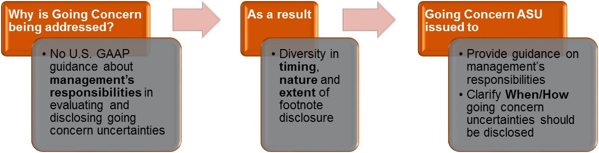
Going Concern
ASU 2014-15 creates a new Subtopic 205-40, Going Concern, under Topic 205, Presentation of Financial Statements

Slide 9
Going Concern
Annual and interim assessment of the likelihood the entity will be unable to meet obligations as they become due for one year from the date the financial statements are issued or available to be issued
Substantial doubt = probable the entity will be unable to meet its obligations for one year from financial statement issuance date
Consider relevant conditions or events that are known and reasonably knowable
Effective for annual periods ending after December 15, 2016 and interim periods thereafter

Slide 10
Going Concern
Assessment Period
One year from date of issuance
Look-forward period under accounting standard
One year from balance sheet date
Look-forward period under auditing standards
12/31/X1
3/1/X2
12/31/X2
3/1/X3
Balance Sheet Date
Financial Statement Issuance Date =
Assessment Date

Slide 11
Going Concern
Management’s Plans
Assessment of substantial doubt includes evaluation of the mitigating effect of management’s plans
Mitigating effect can only be considered if:
Probable the plans will be effectively implemented within assessment period
Probable the plans will alleviate substantial doubt within assessment period
If management’s plans do not meet both of these criteria, they cannot be considered in the substantial doubt evaluation

Slide 12
Going Concern
Disclosures
Substantial doubt overcome by management’s plans
Substantial doubt not overcome
Principal conditions and events that raised substantial doubt
Principal events and conditions that raised substantial doubt
Management’s evaluation of the significance of those conditions and events
Management’s plans that are intended to mitigate the conditions or events that gave rise to the substantial doubt
Subsequent disclosures
Required disclosures continue as substantial doubt persists
Disclosures should become more extensive as additional information is obtained
Disclose how relevant conditions and events were resolved in period substantial doubt is no longer reached
Disclosure of management’s plans that alleviated the substantial doubt
Management’s evaluation of the significance of those conditions and events

Slide 13
ASU 2014-17, Pushdown Accounting (a consensus of the EITF)

Slide 14
Pushdown Accounting
Background
Background
Pushdown accounting is the practice of adjusting the stand-alone financial statements of an acquired entity (the “acquiree”) to reflect the accounting basis of the investor (or “acquirer”).
Such new basis is typically the fair value of the identifiable assets acquired and liabilities assumed.
Under current U.S. GAAP, there is limited guidance for determining when, if ever, pushdown accounting should be applied.
The SEC has provided guidance for SEC registrants on pushdown accounting, which indicates that if a purchase transaction results in an entity becoming substantially wholly owned, its standalone financial statements should be adjusted to reflect the basis of accounting of the acquirer.
Scope: If a new accounting basis is to be established, at what level of change in ownership should it be required?

Slide 15
Pushdown Accounting
Example
Background: Assume Purchase Co. acquires 70% of the voting stock of Little Co. from an unrelated third-party for consideration equal to $50 million and the acquisition results in the generation of goodwill (Little Co. is worth $72 million)
Little Co.’s book equity was $10 million before the acquisition and Little Co. will continue to issue stand-alone financial statements following the acquisition.
  If pushdown accounting was applied upon the change in control event, Little Co. would establish a new basis for its assets and liabilities on its stand-alone financial statements at $72 million.
Purchase Co.
Little Co.
70% Voting Stock

Slide 16
Pushdown Accounting
Decisions
  Pushdown accounting is now optional for all acquired entities upon a change-in-control event (or may be elected in a subsequent period as a change in accounting principle)
  Once pushdown accounting is applied, that election is irrevocable
  A subsidiary of an acquiree is eligible to elect pushdown accounting even if the parent/acquiree elects not to apply it
  Additional guidance on acquisition related debt, goodwill, and bargain purchase gains
  Disclosure requirements for companies that elect pushdown accounting consistent with the requirements in ASU 2015-08, ASC Topic 805, Business Combinations
  The new guidance is effective immediately
  Prospective transition required, may elect for prior transactions
SEC Response
Rescinded its guidance on pushdown accounting, which provided bright lines for when an SEC registrant is and is not required (or allowed) to apply pushdown accounting
Updated its Financial Reporting Manual to be consistent with the new standard
Both SEC registrants and non-SEC registrants will now follow the new guidance.

Slide 17
ASU 2014-18, Accounting for Identifiable Intangible Assets in a Business Combination (a consensus of the PCC)

Slide 18
    Accounting for Identifiable Intangible Assets in a Business Combination (a Consensus of the PCC)
Private companies can elect not to recognize separately from goodwill the following intangible assets:
Noncompetition agreements
Customer-related intangibles unless they are capable of being sold or licensed independently from other assets of the business*
* Examples of customer-related intangible assets that may require separate recognition (i.e., are not eligible for the alternative) include mortgage servicing rights, commodity supply contracts, core deposits, and customer information.

Slide 19
    Accounting for Identifiable Intangible Assets in a Business Combination (a Consensus of the PCC)
If elected, must also elect goodwill alternative in ASU 2014-02
Existing goodwill associated with previous transactions should be amortized prospectively as of the adoption of this alternative
New goodwill arising as a result of an in-scope transaction must be amortized
Election of the accounting alternative to amortize goodwill under ASU 2014-02 does not require the adoption of this update

Slide 20
Accounting for Identifiable Intangible Assets in a Business Combination (a Consensus of the PCC)
Transition: Prospectively for combinations entered into after adoption date. No option to apply retrospective application. Existing NCAs and CRIs are not subsumed into Goodwill.
Effective Date: First annual period after Dec. 15, 2015, and interim periods within annual periods after Dec. 15, 2016. Early adoption for any annual period for which the annual financial statements have not yet been made available for issuance
Private
Companies
1st annual
period
& interim periods thereafter
Q1
Q2
Q3
YE
Q1
Q2
Q3
Dec. 15, 2015

Slide 21
ASU 2015-03, Simplifying presentation of Debt Issuance Costs

Slide 22
Simplifying the Presentation of Debt Issuance Costs
Current U.S. GAAP – Costs paid to third-parties directly related to issuing debt presented as deferred charges (i.e., assets)
ASU 2015-03 – Debt issuance costs presented in the balance sheet as a direct deduction from recognized debt liabilities
Consistent with presentation of debt discounts
More closely aligns U.S. GAAP with IFRS
Consistent with Concepts Statement 6
ASU does not address the presentation of debt issuance costs before the debt liability is recognized
Recognition and measurement guidance of debt issuance costs remains unchanged
Continue to track debt issuance costs separately from debt discounts

Slide 23
Simplifying the Presentation of Debt Issuance Costs
Public business entities
Fiscal years, and interim periods within those fiscal years, beginning after December 15, 2015
All other entities
Fiscal years beginning after December 15, 2015, and interim periods within fiscal years beginning after December 15, 2016
Retrospective application required
Early adoption permitted
Disclosures for change in accounting principle

Slide 24
Simplifying the Presentation of Debt Issuance Cost
Illustrative Example
    On December 31, 201X, an entity issues a noninterest bearing debt security due in two years, with a face amount of $1,000,000 to an investor for $907,030. On the same date, the entity incurs and pays issuance costs of $25,000 to parties other than the investor.
    Presentation of debt issuance costs on December 31, 201X, under the existing standard, and under the new standard are as follows:
    Existing Standard New Standard
    Debt issuance costs (asset) $ 25,000 $ n/a
    Noninterest bearing note $ 1,000,000 $ 1,000,000
    Less unamortized discount 92,970 92,970
    Less unamortized debt
    issuance costs n/a 25,000
    Note payable, net $ 907,030 $ 882,030

Slide 25
Simplifying the Presentation of Debt Issuance Cost
SEC Staff Announcement – June 18, 2015
On April 7, 2015, the FASB issued Accounting Standards Update No. 2015-03, Interest—Imputation of Interest (Subtopic 835-30): Simplifying the Presentation of Debt Issuance Costs, which requires entities to present debt issuance costs related to a recognized debt liability as a direct deduction from the carrying amount of that debt liability. The guidance in Update 2015-03 does not address presentation or subsequent measurement of debt issuance costs related to line-of-credit arrangements.
Given the absence of authoritative guidance within Update 2015-03 for debt issuance costs related to line-of-credit arrangements, the SEC staff would not object to an entity deferring and presenting debt issuance costs as an asset and subsequently amortizing the deferred debt issuance costs ratably over the term of the line-of-credit arrangement, regardless of whether there are any outstanding borrowings on the line-of-credit arrangement .

Slide 26
ASU 2015-11, Simplifying the Measurement of Inventory

Slide 27
Simplifying the Subsequent Measurement of Inventory
Initiative to simplify existing accounting guidance where possible
Modifies LCM guidance contained in ASC 330 for entities using FIFO or average cost
Eliminates “market” concept - replacement cost, limited to net realizable value (ceiling) and net realizable value adjusted for a normal profit margin (floor)
Replaces with net realizable value
Result: inventory will be measured at lower of cost and net realizable value
Effective date and transition
Prospective adoption
ASU 2015-11 issued July 2015
No change for LIFO and retail inventory methods
Effective fiscal years beginning after December 15, 2016 for public business entities
Early adoption is allowed
Required disclosure regarding nature and reason for the change

Slide 28
Simplifying the Subsequent Measurement of Inventory
Inventory Measurement Example - Assumptions
Inventory cost
= $100
Net realizable value
= $99
Replacement cost
= $88
Net realizable value less normal profit margin
= $90

Slide 29
Simplifying the Subsequent Measurement of Inventory
Example Under Current GAAP
The entity compares the cost to the replacement cost of the inventory item.
Replacement cost is less than the original cost, but further analysis is necessary to determine the write-down.
Market value is equal to replacement cost only if it does not exceed NRV and does not fall below NRV less an approximately normal profit margin.
The inventory is written down to the NRV less normal profit margin of $90 per unit.

Slide 30
Simplifying the Subsequent Measurement of Inventory
Example Under ASU 2015-11
The entity compares the cost to the NRV of the inventory.
The inventory would be written down to the NRV of $99 per unit.

Slide 31
ASU 2015-15, Deferral of the Effective Date of Revenue Recognition

Slide 32
Deferral of Effective Date: Revenue Recognition
Public business entities, certain not-for-profit entities, and certain employee benefit plans
  Annual reporting periods beginning after December 15, 2017 (including interim reporting periods within that reporting period)
  Early application permitted as of annual reporting periods beginning after December 15, 2016 (including interim reporting periods within that reporting period)
All other entities
  Annual reporting periods beginning after December 15, 2018, and interim reporting periods within annual reporting periods beginning after December 15, 2019
  Early application permitted as of annual reporting periods beginning after December 15, 2016 (including interim reporting periods within that reporting period)
  Early application permitted as of annual reporting periods beginning after December 15, 2016 and interim reporting periods in the within annual reporting period beginning one year after the period of adoption

Slide 33
FASB/EITF/PCC projects

Slide 34
Current FASB Agenda
Framework Projects | Stage
Conceptual Framework: Measurement | Initial Deliberations
Conceptual Framework: Presentation | Initial Deliberations
Disclosure Framework: Board’s Decision Process | Exposure Draft Redeliberations

Slide 35
Current FASB Agenda
Recognition and Measurement: Broad Projects | Stage
Accounting for Financial Instruments: Classification and Measurement | Drafting final standard (Q4 2015)
Accounting for Financial Instruments: Impairment | Drafting final standard (Q4 2015)
Leases | Drafting final standard (Q4 2015)
Accounting for Financial Instruments: Hedging | Drafting Exposure Draft (Q4 2015)
Insurance: Targeted Improvements to the Accounting for Long-Duration Contracts | Exposure Draft Redeliberations

Slide 36
Current FASB Agenda
Recognition and Measurement: Narrow Projects | Stage
Accounting for Goodwill for Public Business Entities and Not-for-Profit Entities | Initial Deliberations
Accounting for Identifiable Intangible Assets in a Business Combination for Public Business Entities and Not-for-Profit Entities | Initial Deliberations
Accounting for Income Taxes: Intra-Entity Asset Transfers and Balance Sheet Classification of Deferred Taxes | Exposure Draft Redeliberations
Accounting for Measurement Period Adjustments in a Business Combination | Drafting final standard (Q3 2015)
Clarifying the Definition of a Business (phase 1) | Drafting Exposure Draft (Q3 2015)
Employee Share-Based Payment Accounting Improvements | Exposure Draft (Comment Period ended August 14, 2015)
Liabilities and Equity: Targeted Improvements | Initial Deliberations
Revenue Recognition: Identifying Performance Obligations and Licenses | Exposure Draft Redeliberations

Slide 37
Current FASB Agenda
Recognition and Measurement: Narrow Projects | Stage
Revenue Recognition: Narrow-Scope Improvements and Practical Expedients | Drafting Exposure Draft (Q3 2015)
Revenue Recognition: Principal versus Agent (reporting revenue gross versus net) | Drafting Exposure Draft (Q3 2015)
Simplifying the Equity Method of Accounting | Exposure Draft Redeliberations
Technical Corrections and Improvements | Initial Deliberations

Slide 38
Current FASB Agenda
Presentation and Disclosure Projects | Stage
Disclosure Framework—Entity’s Decision Process | Drafting Exposure Draft (Q3 2015)
Disclosure Framework—Disclosure Reviews
- Defined Benefits Plans | Drafting Exposure Draft (Q3 2015)
- Fair Value Measurement | Initial Deliberations
- Income Taxes | Initial Deliberations
- Inventory | Initial Deliberations
- Interim Reporting | Initial Deliberations
Disclosures about Interest Income on Purchased Debt Securities and Loans | Initial Deliberations
Disclosures by Business Entities about Government Assistance | Drafting Exposure Draft (Q4 2015)

Slide 39
Current FASB Agenda
Presentation and Disclosure Projects | Stage
Financial Statements for Not-for-profit Entities | Exposure Draft (Comment Period ends August 20, 2015)
Improving the Presentation of Net Periodic Cost and Net Periodic Postretirement Benefit Cost | Drafting Exposure Draft (Q3 2015)
Simplifying the Balance Sheet Classification of Debt | Drafting Exposure Draft (Q4 2015)

Slide 40
EITF Agenda
Issue | Status
Issue 15-E: Contingent Put and Call Options in Debt Instruments | Exposure Draft (Comment period Oct 5, 2015)
Issue 15-D: Effect of Derivative Contract Novations on Existing Hedge Accounting Relationships | Exposure Draft (Comment period Oct 5, 2015)
Issue 15-B: Recognition of Breakage for Prepaid Stored-Value Cards | Exposure Draft Redeliberations
Issue 15-F: Statement of Cash Flows: Classification for Certain Cash Receipts and Cash Payments | Initial deliberations

Slide 41
Private Company Council Agenda
Issue | Status
15-01: Preferability Assessment and Transition of PCC Alternatives | Drafting Exposure Draft

Slide 42
Accounting for Financial Instruments: Classification and Measurement

Slide 43
Decisions Reached to Date
Retain existing U.S. GAAP for Financial Instruments, except for the following.
Investments in equity securities will be measured at FV-NI, except
  Equity method investments
  Equity securities without readily determinable fair value (Marked to observable price changes)
Fair value change resulting from own credit for financial liabilities measured under fair value option will be recognized through OCI
Valuation allowance on a DTA related to an AFS debt security to be assessed in combination with other DTAs
Disclosures Changes
  Private entities not required to disclose fair value of financial instruments not recognized at fair value in Balance Sheet
  Reduced disclosures for public entities about fair value information of financial instruments not recognized at fair value in Balance Sheet

Slide 44
Reasons for retaining U.S. GAAP
Lack of a Clear Decrease In Complexity of the Guidance on Accounting for Financial Instruments
Lack of a Significant Increase in the Usefulness of the Financial Information Provided
Different Guidance for Financial Assets and Financial Liabilities

Slide 45
Accounting for Financial Instruments: Impairment

Slide 46
Impairment . . . CECL Overview
At each reporting date, the allowance for credit losses will be based on expected credit losses of financial assets as of the reporting date
Reflects more forward looking information
Reflects management expectations based on past events, current conditions, and reasonable and supportable forecasts
Incorporates expected losses over estimated life at the reporting date
CECL Misunderstandings
Not a CECL Application | .75% (historical annual loss rate) * 300,000 (par amount) *30 (contractual life) = $67,500
Not a CECL Application | .75% (historical annual loss rate) * 300,000 (par amount) * 7 (weighted average life) = $15,750

Slide 47
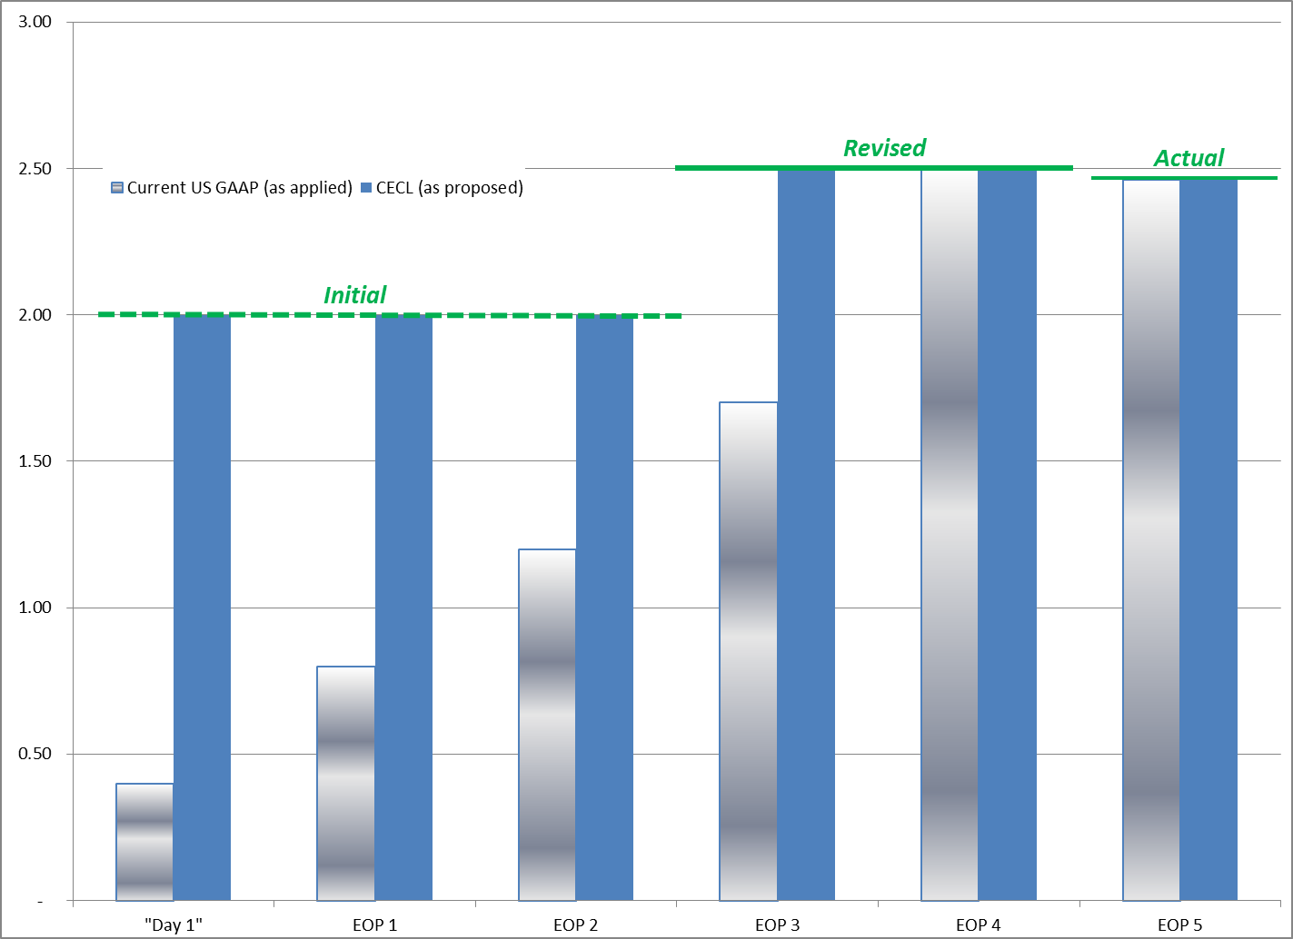
Summary of Impairment Models
Current Expected Credit Loss (CECL) vs. Current GAAP
Cumulative Credit Losses
as % of Loan Balance
    At origination, record lifetime expected losses
      Today, nothing recognized until default is probable; as typically applied = 12-18 months
    No threshold for recording a loss, thus expected lifetime loss incorporates a level of expected deterioration
      Today, evidence of deterioration required
    Estimates updated each period and flows through provision
      Same as today
Note: Graph is only illustrative; assumes closed pool of commercial loans with most losses emerging in periods 2 and 3, with rise in total expected loss in period 3.

Slide 48
Available-for-Sale Debt Securities
AFS debt securities were excluded from the CECL model during redeliberations
Would apply modified impairment guidance in Current GAAP
An allowance approach would be used for recording credit losses, which would allow for credit loss reversals
Requirement to consider the length of time that fair value of the security has been below amortized cost would be eliminated
When estimating whether a credit loss exists, an entity would no longer be required to consider recoveries or additional declines in fair value after the balance sheet date
AFS disclosures updated for CECL disclosure principles would be retained
OTTI – “AFS Credit Loss Model”

Slide 49
Purchased Financial Assets With Credit Deterioration (PCD)
Definition: Acquired individual financial assets (or acquired groups of financial assets with shared risk characteristics at the date of acquisition) that have experienced a more than insignificant deterioration in credit quality since origination, based on the assessment of the acquirer…
PCD Model:
Gross-up presentation on balance sheet
Amortized cost would equal purchase price plus
estimate of expected credit losses
Subsequent Changes in Credit
Flow through allowance and provision in the period
they occur (not through prospective adjustments
to net interest income)
Would be applied to all purchased assets that have
experienced a more than significant credit
deterioration
Scope of PCD Accounting
Not intended to align with current SOP 03-3 scope

Slide 50
CECL Model –Benefits & Concerns
Concerns
    Day 1 losses
    Measurement of expected credit losses for periods beyond reasonable and supportable forecasts may not be reliable
    Does not match the recording of credit loss with interest income recognition
    Concerns over costs to comply in a highly regulated environment
Benefits
    The allowance measures the finanical asset to reflect an entity‘s estimate of what it expects to collect
    Incorporates forward looking information
    Results in more timely reporting of lifetime expected credit losses
    Removes the trigger mechanism to record lifetime losses based on credit deteroriation
    Single measurement objective
    Does not require a loss event to be defined

Slide 51
Impairment . . . Key Redeliberations
Clarifications (to Measurement Principle) Collective evaluation when similar risk characteristics exist (no requirement for multiple outcomes) Periods beyond reasonable and supportable forecasts – revert to historical average Collateral-based practical expedients Expected Credit Loss for contractual term, considering prepayments but not extensions, renewals, modifications unless TDR expected. Consider relevant internal and external information Not required to recognize expected credit loss when expectation of nonpayment of amortized cost is zero | Scope Changes (from Redeliberations) In-Scope Financial guarantees NFP programmatic loans Reinsurance receivables Out of scope 401(k) loans Insurance policy loan receivables Pledges receivable Common control related party receivables AFS debt securities
Disclosures Allowance rollforward requirements continue Credit Quality Indicators – disaggregate class of financing asset by vintage (see example on following slide) Retained disclosures for nonaccrual and write-off policies Collateralized financial asset disclosures would apply only to collateral dependent financial assets Affirmed disclosure requirements for past-due financial assets | Other topics discussed Nonaccrual – no changes from existing guidance TDR- continue to be relevant Acquired assets – Gross-up model only applies to assets with more than insignificant credit deterioration since origination Held for sale – valuation allowance when subsequently identified for sale

Slide 52
Summary of Disclosure Requirements
All financial assets with credit risk (e.g., loans and securities) carried at amortized cost
Objective is to enable users to understand the following:
      The credit risk inherent in the portfolio
      How management monitors the credit quality of the portfolio
      Management’s initial and updated estimates of expected credit losses
User Feedback: They want to understand actual credit results compared to original expectation of lifetime losses through disclosure.

Slide 53
Summary of Disclosure Requirements
Loans Held for Investment and Held to Maturity Securities
Development of Estimate Disclosures
A description of how expected losses are developed Factors that influenced the current estimate of CECL, including a discussion of the changes that influenced management’s decision (changes in loss severity, portfolio composition, volume of assets, etc.) that were not considered in the previous period Reasons for significant changes in the amount of write-offs Amount of significant purchases and sales of debt instruments during each period Amount of any significant sales of financing receivables or reclassifications of financing receivables to held for sale during each period For collateral-dependent assets - type of collateral, loan to value, and any changes that impacted how much collateral secures the asset
Quantitative Disclosures
Disaggregation of credit quality indicators (loan to value, risk rating, geography, etc.) by vintage (see slide 5): Need not exceed more than five annual reporting periods Prior to fifth annual reporting period shown in aggregate Reconciliation between purchase price and par value of purchased assets with credit deterioration

Slide 54
Summary of Disclosure Requirements
Loans Held for Investment and Held to Maturity Securities
Policy Disclosures
Policy for charging off uncollectible debt instruments Changes to the entity’s accounting policies or methodology from the prior period, including the overall quantitative effect of the change Significant changes in estimation techniques used Policy for accounting for nonaccrual financial assets

Slide 55
Vintage Disclosure
Current GAAP
Proposed
 |  | C&I
As of or for the year ended December 31, |  | 2014 | 2013
Loans by risk rating
1 – 2 internal grade |  | $ 49,713 | $ 56,819
3 – 4 internal grade |  | 32,417 | 38,751
5 internal grade |  | 19,037 | 10,951
6 internal grade |  | 2,385 | 2,636
7 – 8 internal grade |  | 294 | 708
Total retained loans |  | $103,846 | $ 109,865
% of total criticized to total retained loans |  | 2.58% | 3.04%
% of nonaccrual loans total retained loans |  | 0.28% | 0.64%
Loans by geographic distribution
Total non-U.S. |  | $ 34,440 | $ 35,494
Total U.S. |  | 69,406 | 74,371
Total retained loans |  | $103,846 | $ 109,865
Net charge-offs / (recoveries) |  | $ 99 | $ (212)
% of net charge-offs / (recoveries) to end-of-period retained loans |  | 0.10% | -0.19%
Loan delinquency
Current and less than 30 days past due and still accruing |  | $103,357 | $ 109,019
30-89 days past due and still accruing |  | 181 | 119
90 or more days past due and still accruing |  | 14 | 19
Criticized nonaccrual |  | 294 | 708
Total retained loans |  | $103,846 | $ 109,865
C&I
2014 | 2013 | 2012 | 2011 | 2010 | Prior years | Revolving Loans | Total
$ 12,855 | $10,974 | $ 7,675 | $ 5,525 | $ 8,764 | $ 1,122 | $ 2,798 | $ 49,713
9,856 | 7,053 | 5,564 | 6,432 | 1,560 | 1,349 | 603 | 32,417
6,792 | 5,443 | 1,642 | 1,520 | 1,862 | 976 | 802 | 19,037
695 | 500 | 381 | 248 | 358 | 83 | 120 | 2,385
86 | 62 | 47 | 31 | 44 | 10 | 14 | 294
$ 27,309 | $22,653 | $17,242 | $11,211 | $16,219 | $ 3,756 | $ 5,456 | $103,846
0.75% | 0.54% | 0.41% | 0.27% | 0.39% | 0.09% | 0.13% | 2.58%
0.08% | 0.06% | 0.04% | 0.03% | 0.04% | 0.01% | 0.01% | 0.28%
$ 10,039 | $ 7,222 | $ 5,497 | $ 3,574 | $ 5,171 | $ 1,197 | $ 1,740 | $ 34,440
20,232 | $14,554 | $11,078 | $ 7,203 | $10,420 | $ 2,413 | $ 3,506 | 69,406
$ 30,271 | $21,776 | $16,575 | $10,777 | $15,591 | $ 3,610 | $ 5,245 | $103,846
$ 29 | $ 21 | $ 16 | $ 10 | $ 15 | $ 3 | $ 5 | $ 99
0.03% | 0.02% | 0.02% | 0.01% | 0.02% | 0.00% | 0.01% | 0.10%
$ 30,128 | $21,674 | $16,497 | $10,727 | $15,518 | $ 3,593 | $ 5,220 | $103,357
53 | $ 38 | $ 29 | $ 19 | $ 27 | $ 6 | $ 9 | 181
4 | $ 3 | $ 2 | $ 1 | $ 2 | $ 0 | $ 1 | 14
86 | $ 62 | $ 47 | $ 31 | $ 44 | $ 10 | $ 15 | 294
$ 30,271 | $21,776 | $16,575 | $10,777 | $15,591 | $ 3,610 | $ 5,245 | $103,846

Slide 56
Questions & Answers

